Slide 1
Standard input, output and error

Slide 2
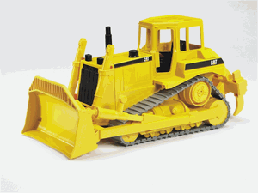
Lecture Under Construction

Slide 3
Contents
Overview of I/O Streams
Character Streams
Byte Streams
Using the Streams
Object Serialization
Working with Random Access files
Standard IO Streams

Slide 4

Overview of I/O Streams
To bring in information, a program opens a stream on an information source (a file, memory, a socket) and reads the information sequentially, as shown in the following figure.

Slide 5

Overview of I/O STREAMS Contd.
Similarly, a program can send information to an external destination by opening a stream to a destination and writing the information out sequentially, as shown in the following figure.

Slide 6
Overview of I/O streams Contd..
The java.io package contains a collection of stream classes that support algorithms for reading and writing. To use these classes, a program needs to import the java.io package.
The stream classes are divided into two class hierarchies, based on the data type (either characters or bytes) on which they operate i.e Character Stream and Byte Stream

Slide 7
Character Streams
Reader and Writer are the abstract superclasses for character streams in java.io.
Reader provides the API and partial implementation for readers ( streams that read 16-bit characters ) and Writer provides the API and partial implementation for writers ( streams that write 16-bit characters).

Slide 8
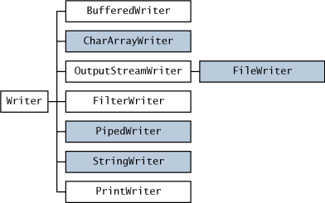
Character Streams Contd.
The following figure shows the class hierarchies for the Reader and Writer classes.

Slide 9
Byte Streams
To read and write 8-bit bytes, programs should use the byte streams, descendents of InputStream and OutputStream .
InputStream and OutputStream provide the API and partial implementation for input streams (streams that read 8-bit bytes) and output streams (streams that write 8-bit bytes).

Slide 10
Byte Streams (cont.)
These streams are typically used to read and write binary data such as images and sounds.
Two of the byte stream classes, ObjectInputStream and ObjectOutputStream, are used for object serialization.

Slide 11
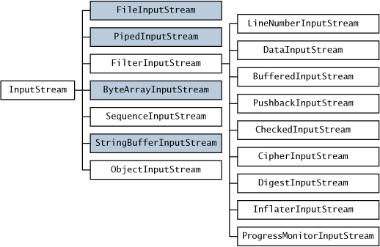
Byte Streams (cont.)
The class hierarchy for the Reader Class

Slide 12
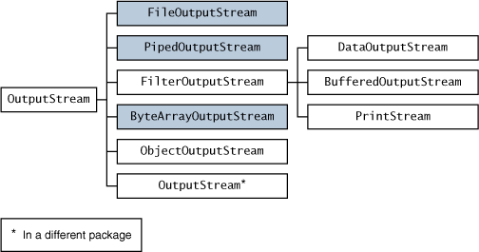
Byte Stream (cont.)
Class hierarchy figure for Writer Class

Slide 13
How to Use File Streams
The file streams-- FileReader , FileWriter , FileInputStream , and FileOutputStream -- read or write from a file on the native file system.
Here is simple code to create a file reader
File inputFile = new File("farrago.txt");
FileReader in = new FileReader(inputFile);
FileWriter out = new FileWriter(outputFile);
This reads characters from the reader as long as there's more input in the input file and writes those characters to the writer.

Slide 14
How to Use Pipe Streams
Pipes are used to channel the output from one thread into the input of another. PipedReader and PipedWriter (and their input and output stream counterparts PipedInputStream and PipedOutputStream ) implement the input and output components of a pipe.

Slide 15
How to wrap a stream
Streams are wrapped to combine the various features of the many streams.
example code:
BufferedReader in = new BufferedReader(source);
The code opens a BufferedReader on source, which is another reader of a different type. This essentially "wraps" source in a BufferedReader. The program reads from the BufferedReader, which in turn reads from source.

Slide 16
How to Concatenate Files
The SequenceInputStream creates a single input stream from multiple input sources.
example code :
ListOfFiles mylist = new ListOfFiles(args); SequenceInputStream s = new SequenceInputStream(mylist);
Here, the mylist object is an enumeration that SequenceInputStream uses to get a new InputStream whenever it needs one.

Slide 17
Working with Filter Streams
The java.io package provides a set of abstract classes that define and partially implement filter streams. A filter stream filters data as it's being read from or written to the stream.
The filter streams are FilterInputStream , and FilterOutputStream .
A filter stream is constructed on another stream (the underlying stream).

Slide 18
Object Serialization
Two stream classes in java.io, ObjectInputStream and ObjectOutputStream, are used to read and write objects.
The key to writing an object is to represent its state in a serialized form sufficient to reconstruct the object as it is read. This process is called object serialization.

Slide 19
Uses of Object Serialization
Remote Method Invocation (RMI)--communication between objects via sockets
Lightweight persistence--the archival of an object for use in a later invocation of the same program.

Slide 20
Working with Random Access Files
A random access file permits non-sequential or random access to a file's contents.
Using Random Access Files
Unlike the input and output stream classes in java.io, RandomAccessFile is used for both reading and writing files. You create a RandomAccessFile object with different arguments depending on whether you intend to read or write.

Slide 21
Standard IO Streams
There are three standard streams, all of which are managed by the java.lang.System class
Standard input--referenced by System.in
  Used for program input, typically reads input entered by the user.
Standard output--referenced by System.out
  Used for program output, typically displays information to the user.
Standard error--referenced by System.err
  Used to display error messages to the user.

Slide 22
References
http://java.sun.com/docs/books/tutorial/essential/TOC.html#io
http://www.codeguru.com/java/tij/tij0114.shtml

